Slide 1
Chapter 8
Homeostasis: Regulation and control

Slide 2
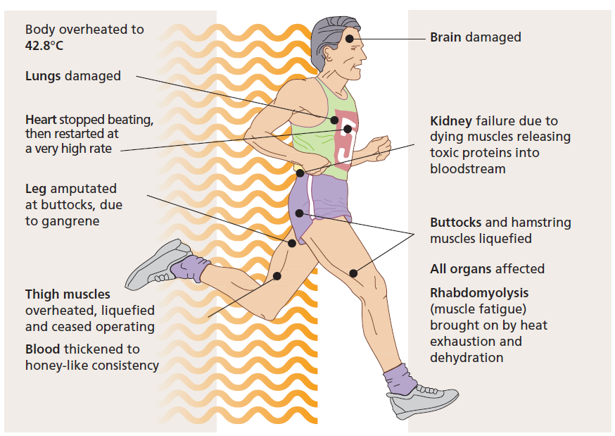
Controlling the internal environment
Our internal environment is carefully controlled and severe consequences can result if this control is not maintained.
In 1988 Mark Dorrity went on an 8 km run in extreme heat.
He could not regulate his temperature or water balance.
Figure 8.1

Slide 3
Detecting stimuli
To maintain an appropriate internal environment, avoid danger and grow and develop normally, organisms must:
Detect
stimuli such as fluctuations in the external and internal environments, growth signals or danger.
Respond
to the stimulus.
The ability to detect and respond allows organisms to:
grow, develop and reproduce
survive challenges in the external environment
maintain homeostasis, the state of having a stable internal environment within narrow limits.

Slide 4
Types of stimuli
Detecting stimuli
Stimuli may be physical (light, heat, pressure) or chemical (hormones, neurotransmitters)
Some examples of stimuli and common responses in humans:
Stimulus | Response
Hot sun | Move to shade, sweat
Something is hot to touch | Rapidly pull hand back
Cold | Shivering (increases metabolic rate, generating heat as a by-product)
Low water content in internal environment | Thirst

Slide 5
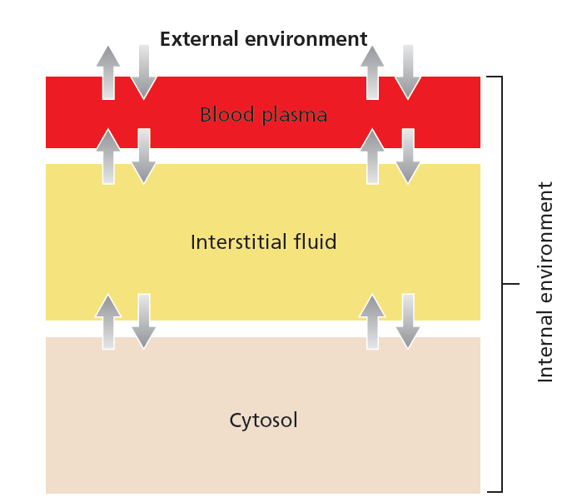
The internal environment
In this context, the internal environment is the cytosol and all extracellular fluid of the body. That is, the interstitial fluid and the blood plasma.
Figure 8.8
Organisms detect and respond to factors in their external and internal environments.

Slide 6
Homeostatic variables
Detecting stimuli
Factors in the internal environment that are subject to homeostatic regulation include:
Body temperature
pH
Carbon dioxide
Oxygen
Ions
(calcium, sodium, potassium etc.)
Red blood cell number
Water
Nutrients
(e.g. glucose)
Blood pressure
Blood volume
If these factors fall outside the narrow homeostatic range, they stimulate a corrective response.

Slide 7
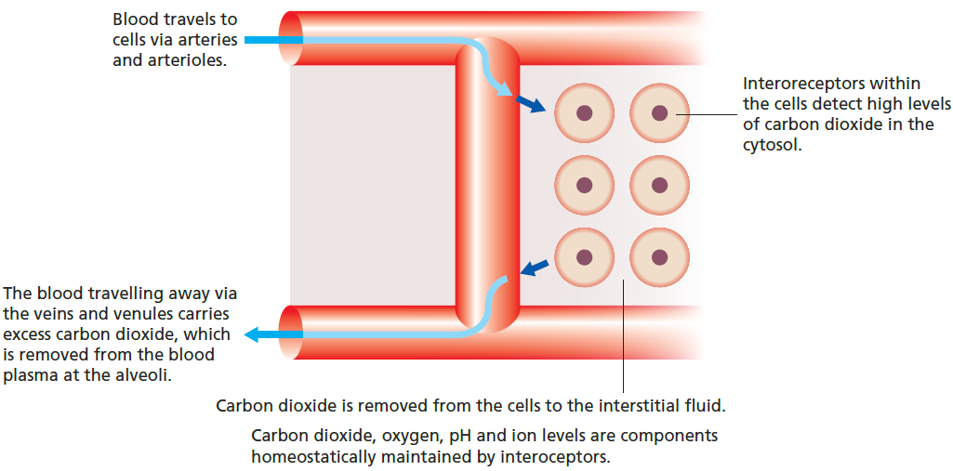
Detecting stimuli
For example, carbon dioxide in the internal environment is removed through the interstitial fluid and blood plasma to the external environment.
A stimulus, such as elevated CO₂, may be detected by intracellular receptors
Drainage of the interstitial fluid into blood vessels and blood flow to the lungs removes CO₂
Figure 8.2

Slide 8
Types of stimuli
Detecting stimuli
When a stimulus is detected, a signal is usually produced, which contains the information needed to respond appropriately.
Detect
Sensors monitor and detect variation from the homeostatic range
Signal
Target
The signal is relayed to a target effector, which brings about the required response.
Respond
Effectors respond to maintain homeostasis

Slide 9
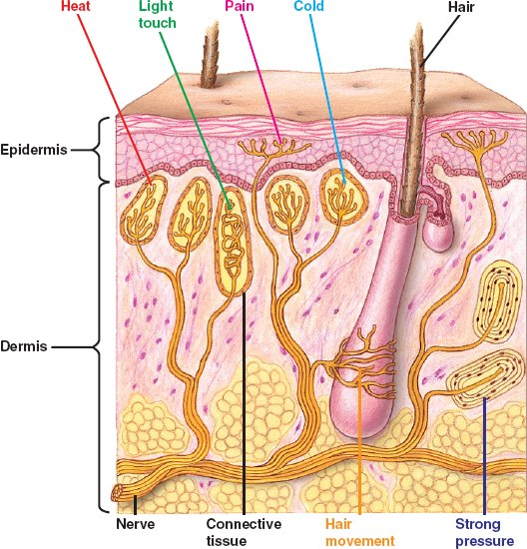
Receptors
Detecting stimuli
Most sensors are receptors.
Receptors can be clusters of cells, such as receptors for heat, pain, touch and pressure in the skin.

Slide 10
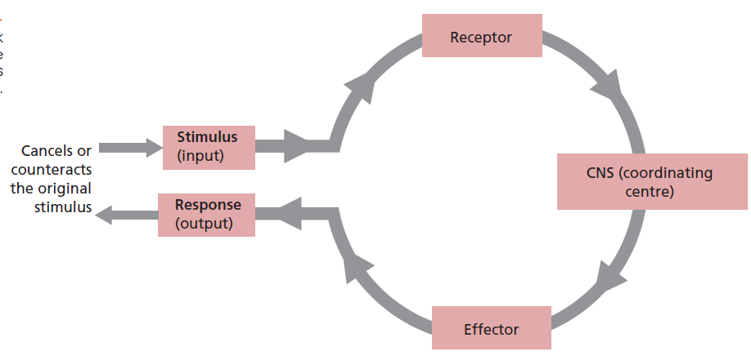
Receptors
Detecting stimuli
Receptors can also be single proteins or molecules expressed on the cell surface or within a cell.
Figure 8.11

Slide 11
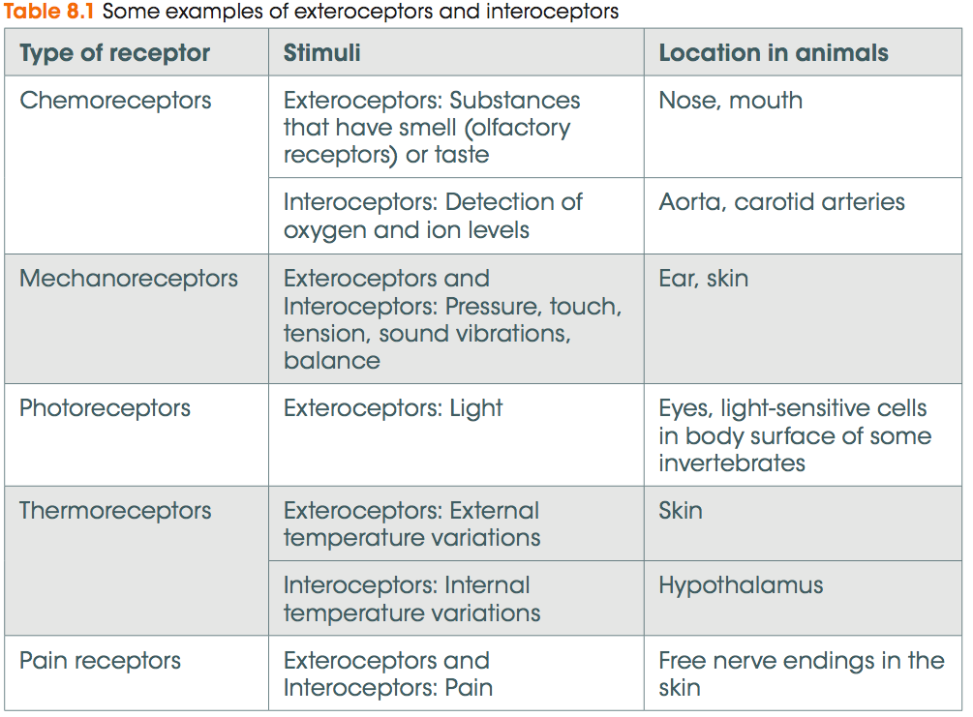
Receptors
Detecting stimuli
Exteroreceptors receive signals from the external environment.
Interoreceptors receive signals from within the body.

Slide 12
Coordinating responses
Detecting stimuli
After a receptor detects a stimulus, a response must be coordinated and executed.
Two main body systems monitor and coordinate responses to stimuli in complex organisms:
The endocrine system uses hormones to communicate
The nervous system uses nerves impulses to communicate

Slide 13
Parts of the nervous system
The nervous system
The brain and spinal cord form the central nervous system (CNS) which processes, store and coordinates information.
All other neurons in the nervous system form the peripheral nervous system (PNS) which transmits information to and from the CNS.
Nerve impulses travel in defined pathways:
Sensory neurons
Effectors are muscles or glands that respond to the stimulus
PNS
CNS
Connecting neurons
Motor neurons

Slide 14
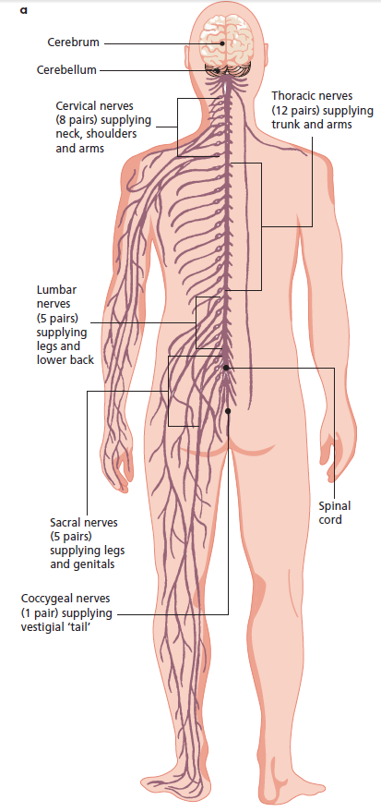
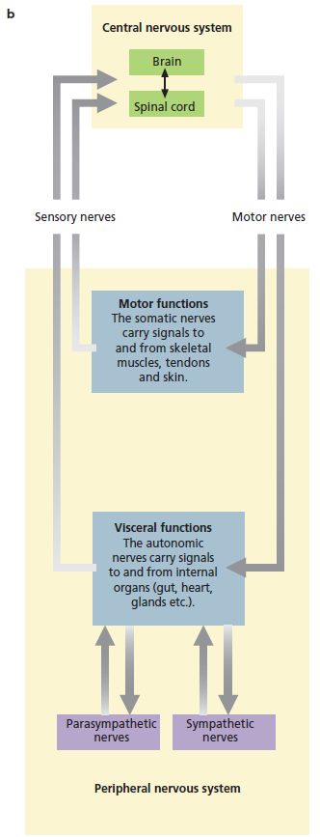
Composition of the nervous system
A general overview of the nervous system
Figure 8.3

Slide 15
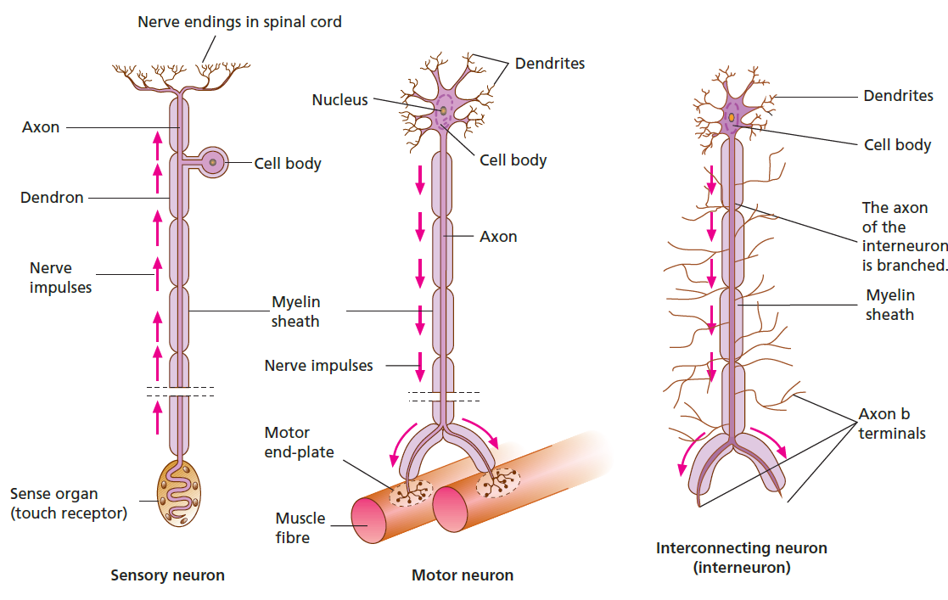
Features of neurons
The nervous system
Neurons have a cell body, an axon and dendrites.
The axon is usually covered by an insulating sheath.
Figure 8.4

Slide 16
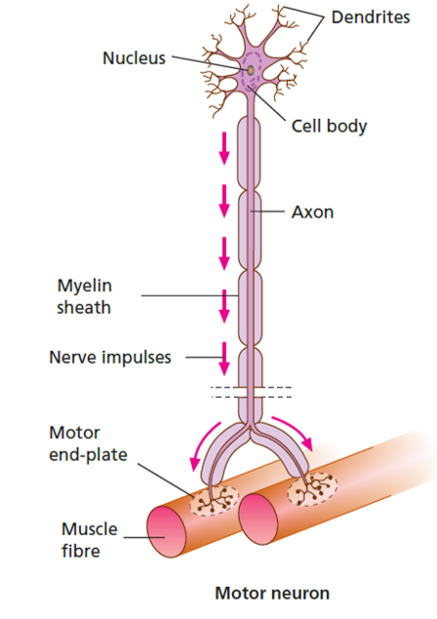
Features of neurons
The nervous system
The insulating sheath surrounding the axon is called myelin.
It is made up of Schwann cells, which wrap around the axon.
Spaces between the Schwann cells are called nodes.
As nerve impulses travel along axons, they can skip from node to node, greatly speeding up the impulse.
Figure 8.4

Slide 17
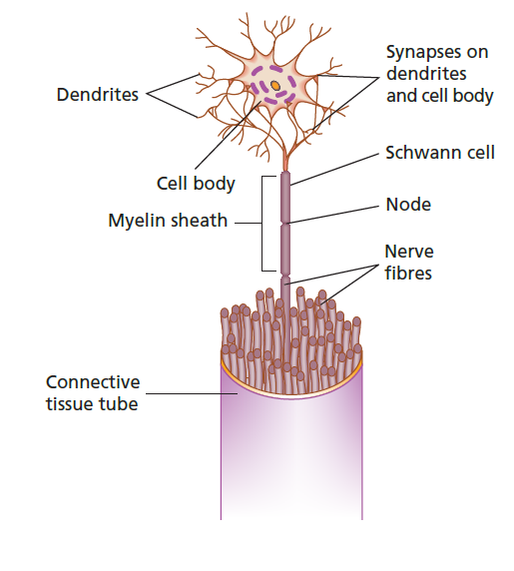
Features of neurons
The nervous system
A nerve is a tube filled with nerve axons surrounded by connective tissue.
Somatic nerves transmit impulses within the somatic nervous system, which stimulates voluntary responses such as skeletal muscle activity.
Autonomic nerves transmit signals within the autonomic nervous system, which organises involuntary responses
such as cardiac and smooth muscle activity.
Figure 8.5

Slide 18
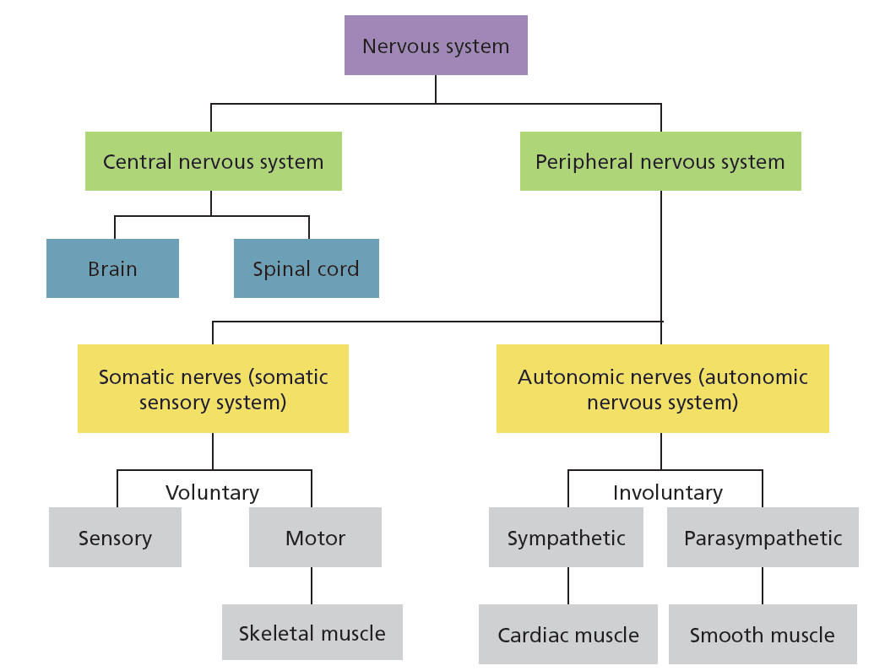
An overview of the nervous system
The nervous system
Figure 8.6

Slide 19
The endocrine system
Not all responses require rapid changes.
Some take time and are under the control of hormones.
Hormones are chemical substances that are secreted by ductless glands directly into the bloodstream.
Hormones can be proteins, steroids, fatty acids and amino acids.
Hormones act upon their particular target cells and tissues to bring about a response.
Only the cells that express a receptor for a hormone will respond to it.

Slide 20
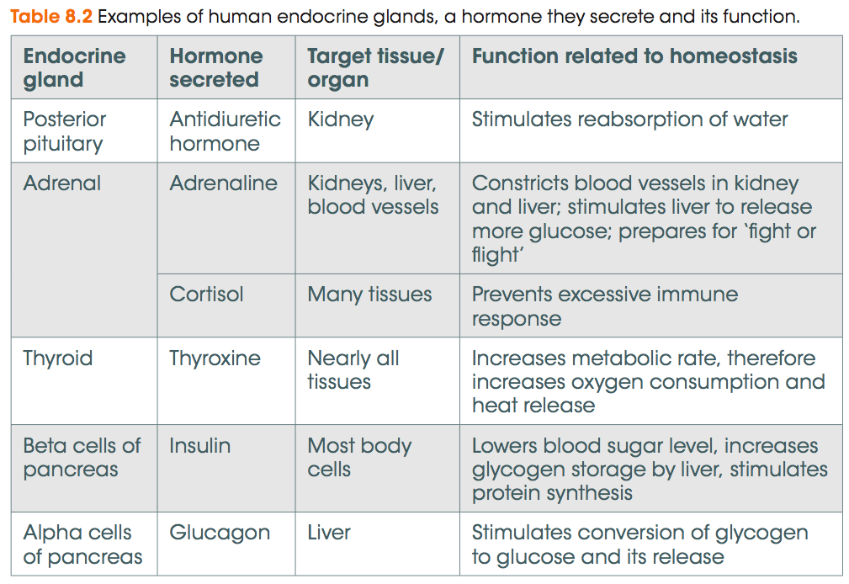
Examples within the endocrine system
The endocrine system

Slide 21
Hormones can have different properties
The endocrine system
Large protein hormones such as insulin are generally detected by receptors that are expressed on the cell surface.
Small hydrophobic hormones such as cortisol can easily pass through the plasma membrane and so their receptors are intracellular.

Slide 22
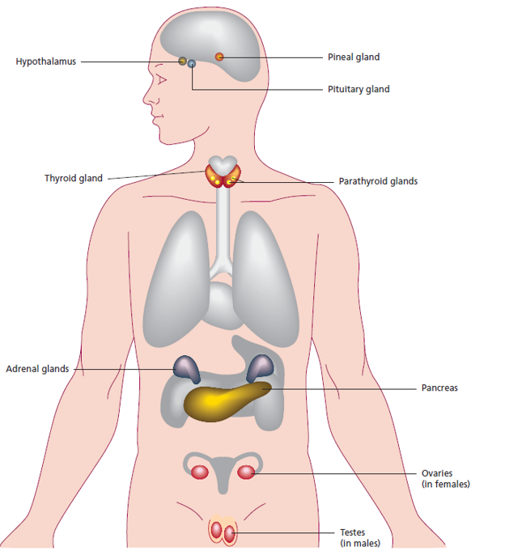
Endocrine organs
The endocrine system
Pituitary gland
Regulates hormone release by other glands
Hypothalamus
Body’s thermostat
Regulates appetite
Regulates the pituitary gland
Thyroid gland
Regulates growth and metabolism
Pancreas
Regulate glucose metabolism and homeostasis
Ovaries and testes
Regulate sex-related phenotypes and reproduction
Adrenal glands
Responsible for ‘fight or flight’ response
Figure 8.7

Slide 23
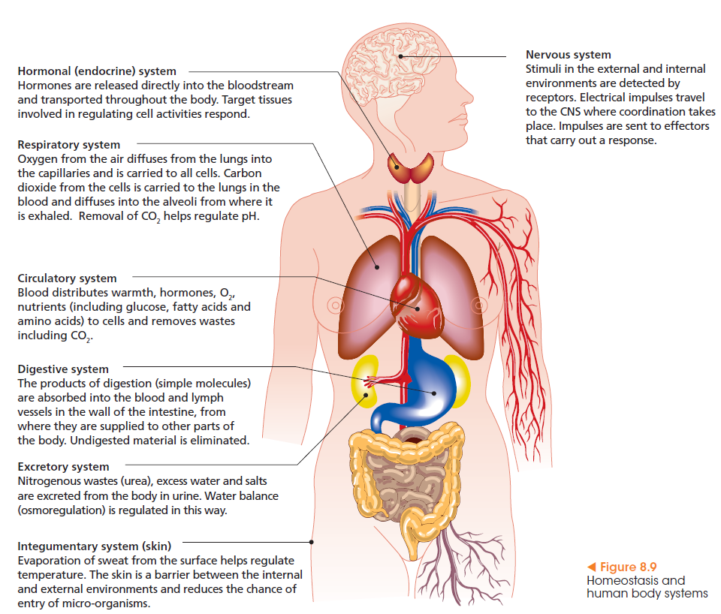
Body systems that contribute to homeostasis
As well as the nervous and endocrine systems, other body systems work together to maintain a balance within narrow limits.

Slide 24
Keeping in narrow limits
Maintaining a balance
Most parameters in the body are kept within a narrow limit.
For example, body temperature in humans is kept at a constant XX, and the consequences of straying outside this range can be dire.

Slide 25
Feedback
Maintaining a balance
Approaching the limits of a narrow homeostatic range can stimulate a response that corrects the balance.
Detect
Starting to fall outside the range
This is the principal of feedback.
Respond
Bring the parameter back to the safe range

Slide 26
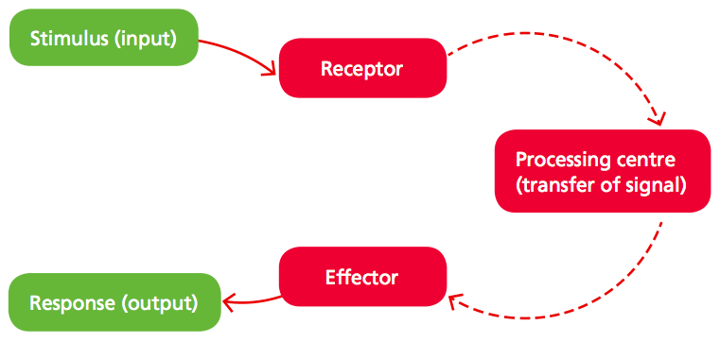
The stimulus-response model
Maintaining a balance
In the stimulus-response model:
A stimulus is detected by a receptor
The information is transferred to a processing centre
The processing centre sends the information to an effector
The effector carries out a response
The stimulus is corrected and no longer stimulates the response
1
2
5
4
3
Figure 8.10

Slide 27
Negative feedback
Maintaining a balance
This is an example of negative feedback, in which the stimulus initiates a response that acts to correct the stimulus.
For example, the stimulus of increasing body temperature initiates a sweating response, which cools the body. Once the body is cooled, the initial stimulus has gone.
1
2
5
4
3
Figure 8.10

Slide 28
Negative feedback
Maintaining a balance
Another example of negative feedback is control of the blood glucose level.
Blood glucose level increases
Blood glucose level drops
Pancreas
Islets of Langerhans cells detect elevated glucose
Pancreas
Islets of Langerhans cells detect low glucose
Alpha cells
Produce less glucagon
Beta cells
Produce more insulin
Alpha cells
Produce more glucagon
Beta cells
Produce less insulin
Liver
Muscle
Liver
Muscle
Absorb glucose and convert it to glycogen for storage
Convert glycogen to glucose and release to bloodstream

Slide 29
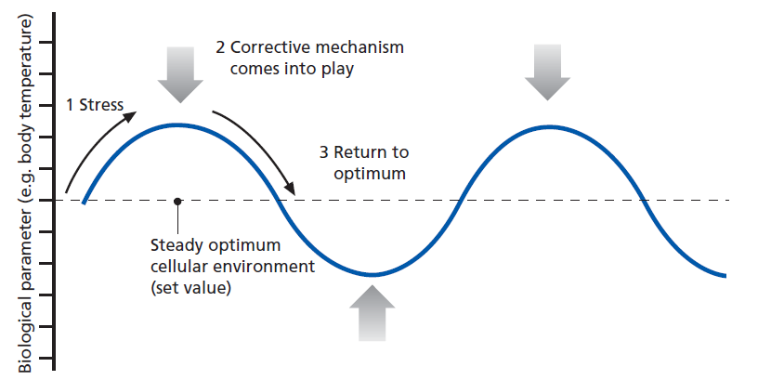
Negative feedback
Maintaining a balance
Negative feedback is very important in homeostasis because it always aims to restore the internal environment to an ideal situation. This is called the set point.
Set point
Figure 8.12
Tolerance limits
Optimum range
Falling outside the tolerance limits may induce physiological stress.

Slide 30
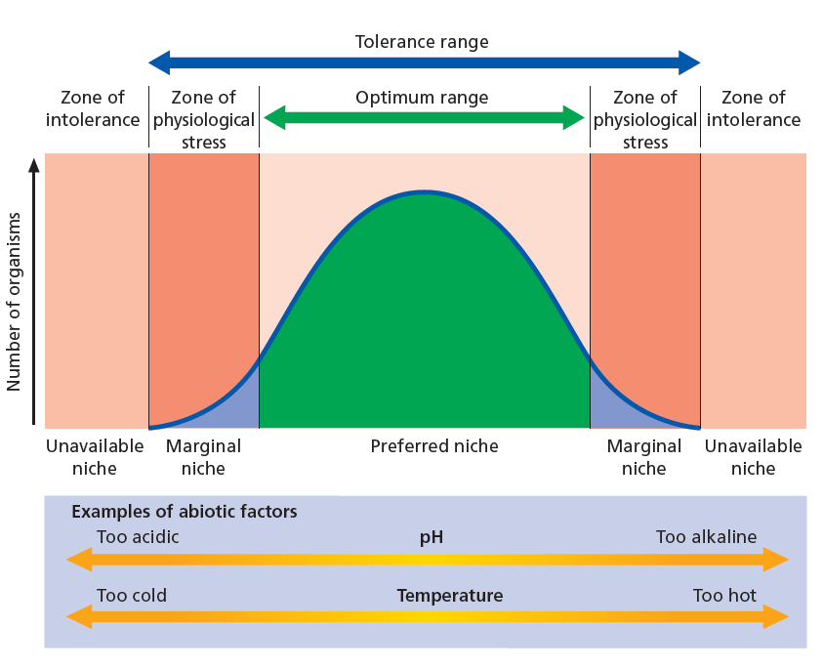
Tolerance range
Maintaining a balance
For most biological parameters (including pH and temperature) there is an optimum range for most individuals.
Organisms that can tolerate the extremes of this range may be able to inhabit a marginal niche.
Figure 8.13

Slide 31
Positive feedback
Maintaining a balance
Occasionally adjustments are made that reinforce the original stimulus.
This positive feedback is usually associated with growth and development rather than homeostasis.
For example, positive feedback stimulates and reinforces the process of metamorphosis of a tadpole to a frog. Once the process has begun, it continues to completion.
Another example is the release of prostaglandins from the placenta during childbirth. These stimulate contractions, and the positive feedback only discontinues when the placenta is delivered.

Slide 32
Positive feedback
Maintaining a balance
In positive feedback, the response reinforces the stimulus.
Figure 8.10

Slide 33
Metabolism
Maintaining a balance
Reactions that occur as part of normal body processes are collectively termed metabolism.
Metabolism is the sum of chemical reactions that maintain life.
Metabolic reactions release energy as heat, which increases body temperature.

Slide 34
Exercise
Maintaining a balance
Exercise increases the demand for energy and so metabolic reactions are increased to keep up the supply.
Muscle contractions require oxygen and glucose
These substrates are broken down in catabolic reactions to fuel muscle contractions
Breathing increases
CO₂ level rises
reduces
Expels CO₂
reduces the rate of
Temperature increases
pH decreases
Enzyme functionality is reduced
Metabolism is slowed

Slide 35
Structure and behaviour
Maintaining a balance
Mechanisms other than metabolic activity and physiological processes can also contribute to the maintenance of homeostasis.
Behaviours can also contribute to homeostasis, for example slowing exercise pace when the body’s temperature increases.
Removing clothing and moving into the shade are also behaviours that help to maintain the correct body temperature.
The maintenance of a stable body temperature in the face of a fluctuating environment is called thermoregulation.

Slide 36
Ectotherms and endotherms
Thermoregulation
Organisms that maintain a constant body temperature within a narrow optimal range are endotherms (also referred to as homeothermic).
Endo = within, therm = heat
Endothermic organisms retain the heat generated by metabolism.
Organisms whose body temperature conforms to and fluctuates with the environment are ectotherms (also referred to as poikilothermic).
Ecto = external, therm = heat
Ectothermic organisms cannot control their internal body temperature.

Slide 37
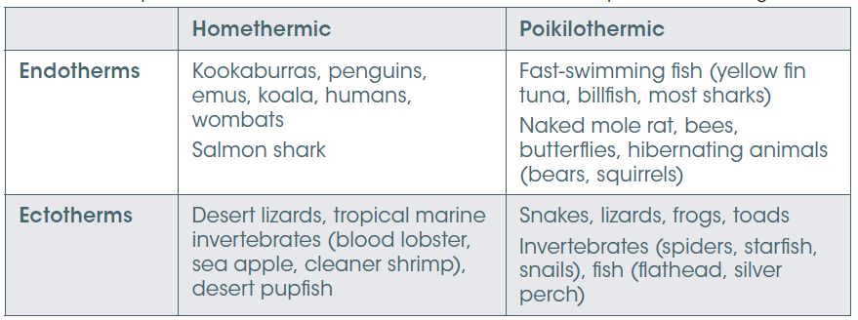
Ectotherms and endotherms
Thermoregulation
Table 8.7 Some examples of endotherms, ectotherms, homoeothermic and poikilothermic organisms.

Slide 38
Strategies for thermoregulation
Thermoregulation
When an organism is cold, it must gain heat from the environment.
Conversely, when hot, an organism must lose heat to the environment.
To understand how this is achieved, it is necessary to understand how heat is transferred.
Conduction movement of heat from a hotter object to a cooler object in contact
Convection movement of heat between an object and air or water
Evaporation loss of heat as water evaporates from the surface of an object
Radiation gain of heat by absorbance of light
loss of heat from an organism by infra-red light

Slide 39
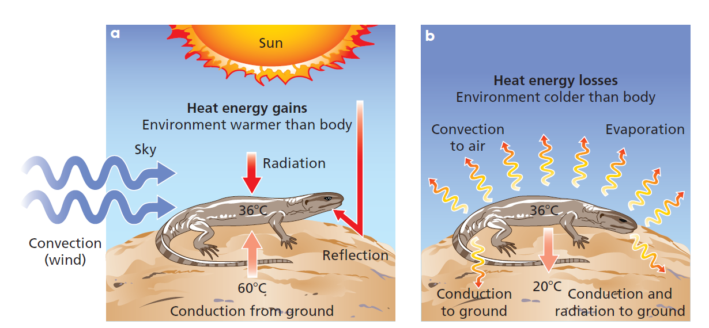
Strategies for thermoregulation
Thermoregulation
Figure 8.16

Slide 40
Strategies for thermoregulation
Thermoregulation
Staying cool in the heat - adaptations include:
Vasodilation Nerve impulses stimulate dilation of arterioles, allowing greater heat loss by radiation.
Sweating Evaporation of sweat cools the skin surface.
Evaporation is greatly assisted by movement of air.
This is the reason a dog pants.
Exposing a larger surface area to the environment can also allow heat loss by radiation.
Elephants ears are probably an adaptation to increase heat loss.

Slide 41
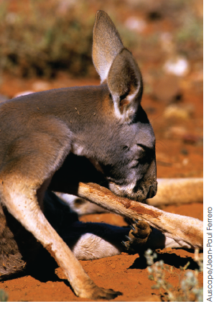
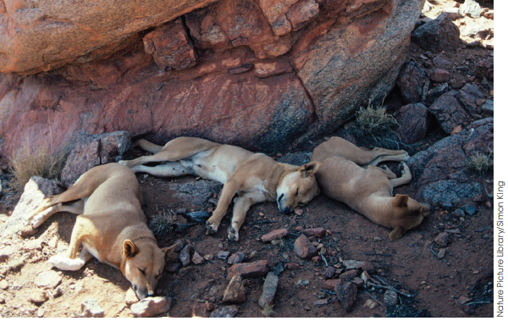
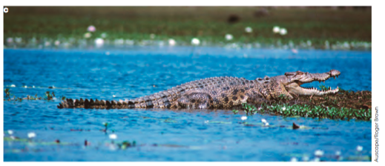
Strategies for thermoregulation
Thermoregulation
Staying cool in the heat - adaptations include:
Behavioural adaptations
Sheltering from the sun
Licking forearms where blood vessels are close to the
surface - the saliva evaporates, cooling the blood
Sheltering in water
Opening the mouth to allow evaporation
Figure 8.15
Figure 8.18

Slide 42
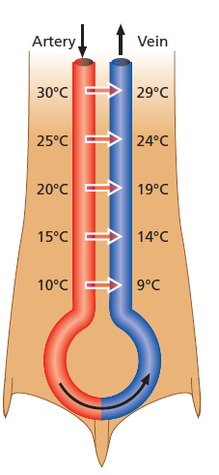
Strategies for thermoregulation
Thermoregulation
Keeping warm in the cold - adaptations include:
Figure 8.23
Insulation Feathers, fur and blubber prevent heat loss
Trapping a layer of air close to the body
Cats look larger on cold days
Piloerection is raising of body hairs to trap a
layer of air
Countercurrent heat exchange
Warm blood travelling to extremities
transfers its heat to cool blood returning
from extremities

Slide 43
Strategies for thermoregulation
Thermoregulation
Keeping warm in the cold - adaptations include:
Size and shape Heat loss is less in larger, rounder organisms so having
a lower surface area to volume ratio reduces heat loss
Behaviours Huddling provides insulation and reduces an organism’s
surface area to volume ratio
Metabolism Increasing the metabolic rate generates more heat
Exercise increases the metabolic rate
Shivering is an adaptation to increase metabolic heat

Slide 44
Thermoregulation
Body temperature falls
Hypothalamus detects temperature drop
Motor neurons deliver signals
Smooth muscle
Skeletal muscle
Thyroid produces thyroxine
Behaviours to increase body heat
Arterioles constrict and blood is diverted to core
Shivering and piloerection activated
Metabolic rate increases
Body temperature increases

Slide 45
Strategies for thermoregulation
Thermoregulation
Keeping warm in the cold - adaptations include:
Hibernation When heat-generating behaviour and adaptations are
not sufficient to keep an organism’s body temperature
above the lower critical temperature, it may enter a state
of hibernation.
The set point is lowered considerably and the metabolic
rate falls to a level that just sustains life.

Slide 46
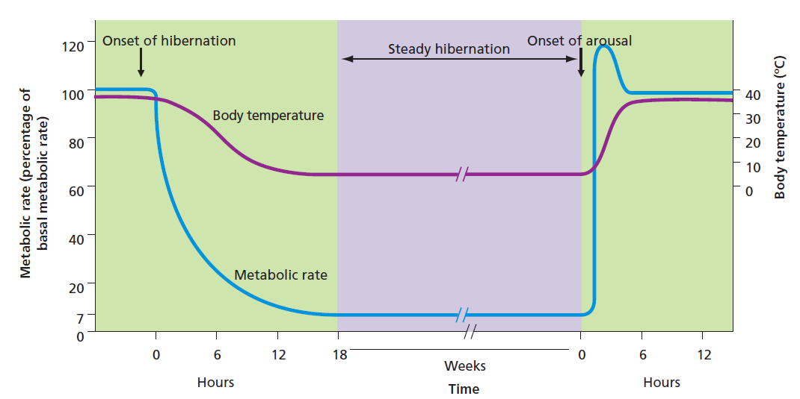
Strategies for thermoregulation
Thermoregulation
Hibernation
Figure 8.26
A different type of dormancy, aestivation, is a response to dry conditions.
Snails retreat into their shell and seal it off, for example.

Slide 47
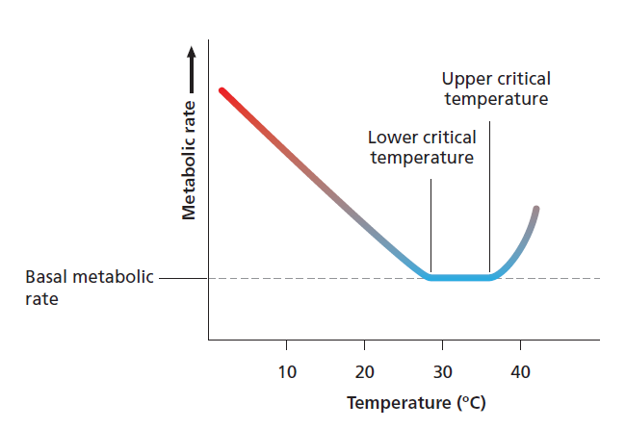
Strategies for thermoregulation
Thermoregulation
On the other hand, the upper critical temperature is reached when cooling mechanisms fail and the metabolic rate increases as the external temperature increases.
Figure 8.25

Slide 48
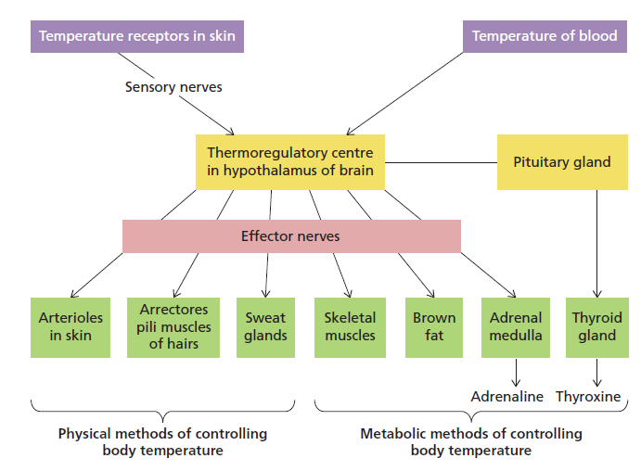
Thermoregulation in mammals
Thermoregulation
Figure 8.17

Slide 49
Water is essential to life
Osmoregulation
Water is sometimes referred to as the universal solvent and is essential to life.
Homeostatic regulation of water is termed osmoregulation.
Present in all tissues
Transports nutrients and dissolved gases
Dissociates ions
to allow metabolic reactions
Removes wastes

Slide 50
Kidneys regulate water balance
Osmoregulation
The kidneys 1. Remove nitrogenous wastes from the body
2. Regulate water concentration in the blood
3. Maintain ion levels in the blood
Nitrogenous wastes come from the synthesis of proteins. They occur in three biological forms:
Ammonia – least toxic
Urea – intermediate toxicity
Uric acid – least toxic
Different organisms have adapted the use of one of these different waste forms depending on their environmental demands.

Slide 51
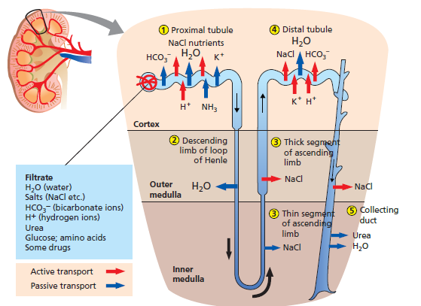
Kidneys regulate water balance
Osmoregulation
The functional unit of the kidney is the nephron.
In the glomerulus, blood plasma is filtered from fine capillaries.
Figure 8.28
Filtrate is collected in the Bowman’s capsule.
Filtrate travels through the loop of Henle, along which nutrients and proteins are reabsorbed back into the bloodstream.

Slide 52
Hormonal control of water balance
Osmoregulation
Hypothalamus detects too little water in the blood
stimulates
Pituitary gland releases vasopressin
negative feedback to oppose original stimulus
travels via circulation to kidneys
Stimulates water reabsorption by kidneys
Stimulates secretion of Na⁺ ions
Less water is excreted by kidneys
More Na+ is secreted into urine
Blood osmolarity returns to normal

Slide 53
Kidneys regulate water balance
Osmoregulation
Mechanisms to reduce water loss include:
Reptiles and birds reabsorb water from their cloaca, the cavity into which their ureter and rectum open.
Terrestrial vertebrates can slow the production of urine by reducing the glomerular filtration rate.
The Australian desert frog can also swell and store its urine for use in the dry season.
Having longer loops of Henle allow organisms to concentrate their urine.
The desert hopping mouse Notomys alexis can concentrate its urine more than any other known rodent.
Camels can tolerate water loss and concentration of their body’s fluids.

Slide 54
Osmoregulators and osmoconformers
Osmoregulation
Organisms that regulate their osmotic concentration to be either higher or lower than the external environment (such as by controlling kidney function) are osmoregulators.
Organisms that allow their osmotic concentration to be equal to the environment are osmoconformers.

Slide 55
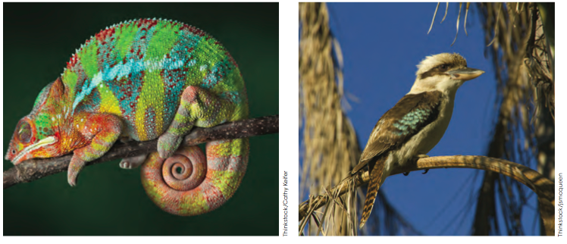
Osmoregulators
Osmoregulation
Many different mechanisms have evolved to reduce water loss by organisms.
In animals, cooling mechanisms that rely on evaporation can result in water loss, but also induce a thirst response to replace lost water.
Animals also have a range of structural, physiological and behavioural adaptations to maintain their water balance.
Scales
Feathers
Figure 8.29

Slide 56
Osmoregulators
Osmoregulation
Plants have a range of features that help obtain or retain water:
Thick waxy cuticle on the leaf surface
More stomata on the under side of the leaf than the upper
Sunken stomata
Cylindrical or rolled leaves
Hairs on leaves
Tap roots

Slide 57
Osmoregulators
Osmoregulation
Some organisms have body fluids with a higher water concentration (that is, they are hypotonic) than their surroundings.
For example, marine fish live in salty water and have hypotonic body tissues
Other organisms have body fluids with a lower water concentration (that is, they are hypertonic) than their surroundings.
For example, fresh water fish have higher solute concentrations than their surroundings.
In aquatic environments, osmoregulators must overcome osmosis.

Slide 58
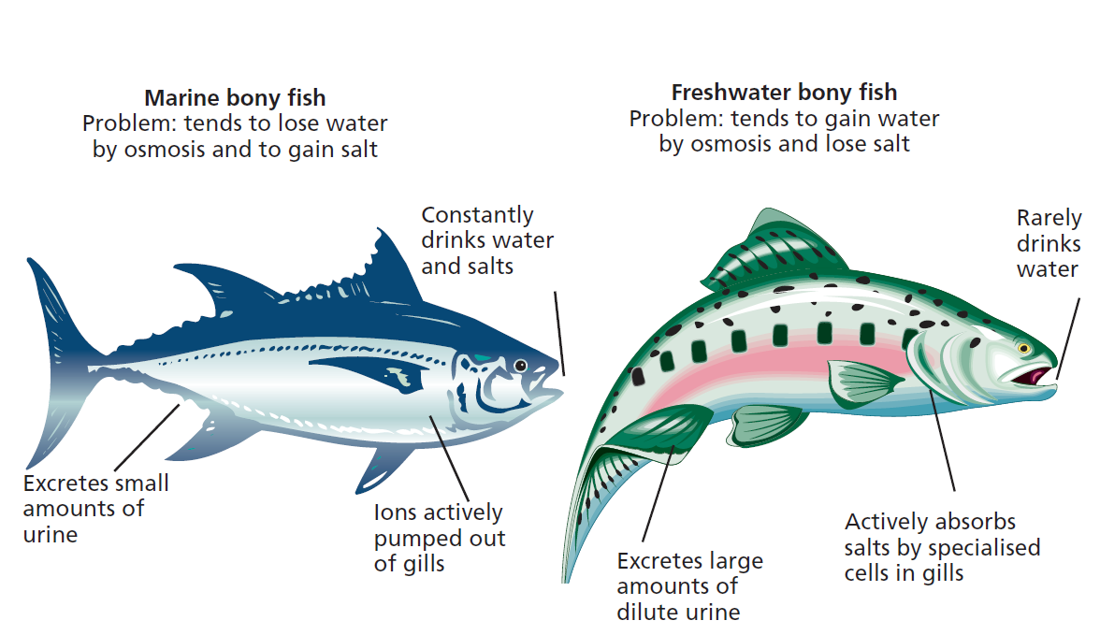
Osmoregulation in aquatic environments
Osmoregulation
Figure 8.31

Slide 59
Osmoregulation in terrestrial environments
Osmoregulation
Some terrestrial animals living in dry environments can undergo aestivation, a hibernation state in which the metabolic rate slows for several months until water is available.
Other animals inhabit burrows, in which the humidity is higher and the temperature lower.
Notomys alexis wraps the bushy end of its tail around its face to trap a humid layer of air between itself and the environment.
Figure 8.33

Slide 60
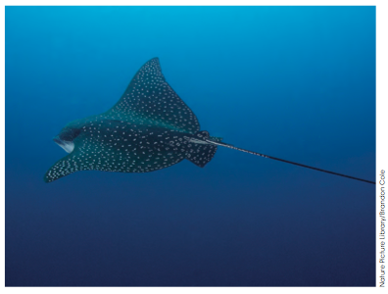
Osmoconformers
Osmoregulation
Figure 8.33
Most marine invertebrates are osmoconformers.
For example, cnidarians and molluscs
Cartilagenous fish are also osmoconformers.
For example, sharks and rays
The water concentration of their interstitial fluid matches the environment and is therefore isotonic.
They are able to concentrate urea in their tissues to match the high concentration of solutes in the ocean.
Organisms that can tolerate fluctuations in salinity in mixes of salt and freshwater are called euryhaline species.

